Slide 1
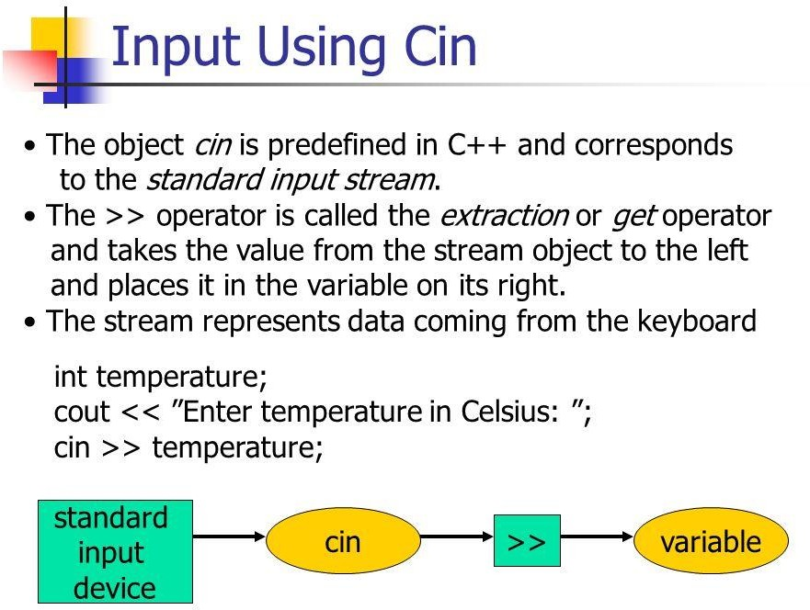

Slide 2
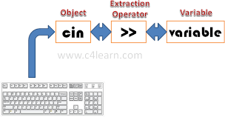
Diagram
The bitwise shift operators are the right-shift operator (>>), which
moves the bits of shift_expression to the righ
Get From operator

Slide 3
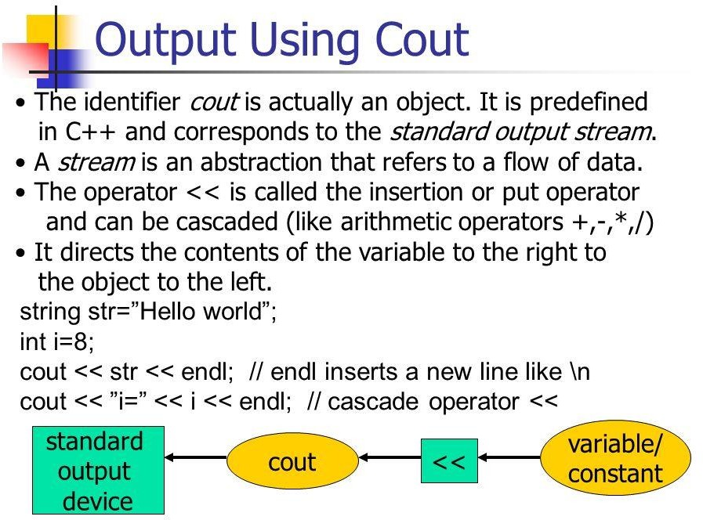

Slide 4
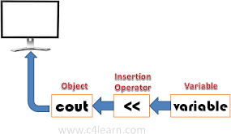
the left-shift operator (<<), which moves the bits of shift_expression to the left.

Slide 5
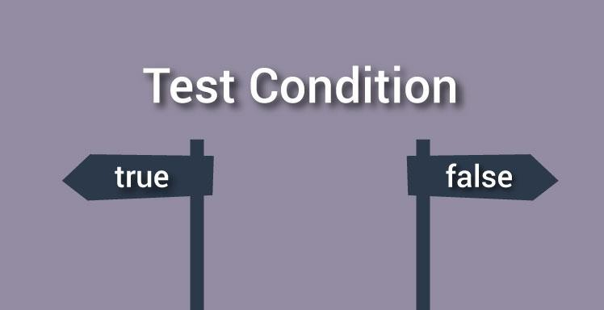
C++ if, if...else and Nested if...else
In this article, you will learn to create decision making statements in a C++ program using different forms of if. else statement.

Slide 6
C++ if Statement
if (testExpression)
{
// statements
}
The if statement evaluates the test expression
inside parenthesis.
If test expression is evaluated to true, statements inside the body of if is executed.
If test expression is evaluated to false, statements
inside the body of if is skipped.

Slide 7
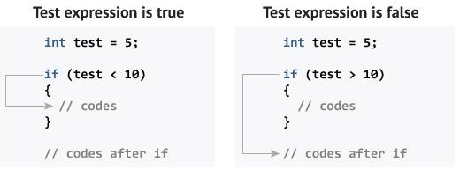
How if statement works?

Slide 8
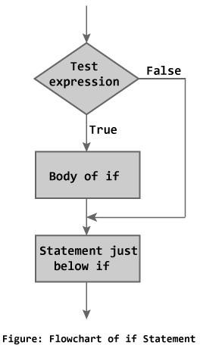
Flowchart of if Statement

Slide 9
Example 1: C++ if Statement
// Program to print positive number entered by the user
// If user enters negative number, it is skipped #include <iostream>
using namespace std; int main()
{
int number;
cout << "Enter an integer: ";
cin >> number; // checks if the number is positive if ( number > 0)
{
cout << "You entered a positive integer: " << number << endl;
}
cout << "This statement is always executed."; return 0;
}

Slide 10
Output
Output 1
Enter an integer: 5
You entered a positive number: 5 This statement is always executed.
Output 2
Enter a number: -5
This statement is always executed.

Slide 11
C++ if...else
The if else executes the codes inside the body of if statement if the test expression is true and skips the codes inside the body of else.
If the
test expression is false, it
executes the codes inside the body of else statement and skips the codes inside the body of if.

Slide 12
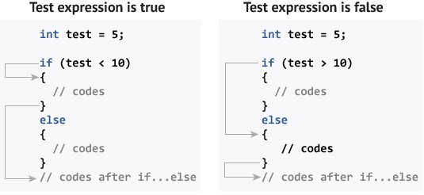
How if...else statement works?

Slide 13
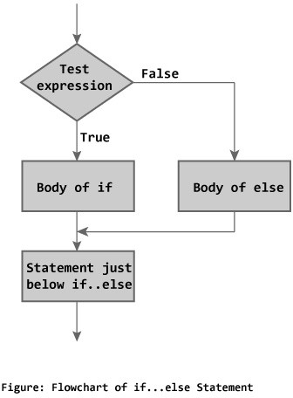
Flowchart of if...else

Slide 14
C++ Nested if...else
#include <iostream>
using namespace std;
int main()
{
float n1, n2, n3;
cout << "Enter three numbers: ";
cin >> n1 >> n2 >> n3;
if (n1 >= n2)
{
if (n1 >= n3)
cout << "Largest number: " << n1;
else
cout << "Largest number: " << n3;
}
else
{
if (n2 >= n3)
cout << "Largest number: " << n2;
else
cout << "Largest number: " << n3;
return 0;
}

Slide 15
Syntax of Ladder elseif
if (testExpression1)
{
// statements to be executed if testExpression1 is true
}
else if(testExpression2)
{
// statements to be executed if testExpression1 is false and testExpression2 is true
}
else if (testExpression 3)
{
// statements to be executed if testExpression1 and testExpression2 is false and
testExpression3 is true
} . . else
{
// statements to be executed if all test expressions are false
}

Slide 16
Switch Statement

